Slide 1
LINEAR SYSTEM CONVOLUTION LINEAR FILTER
CS 111: Digital Image Processing
Aditi Majumder
Notes:
‹#›

Slide 2
Outline
Linear System
Properties
Response
Convolution
Concept
Properties
Linear Filter
Low pass, High pass, Aliasing…
Notes:
‹#›

Slide 3
Properties of Linear System
‹#›
Homogeneity:
Additivity:
Shift Invariance:

Slide 4
Other Properties of Linear Systems
‹#›
Commutative:
Superposition: If each generates multiple outputs, Then the addition of inputs generates an addition of outputs.

Slide 5
Decomposition - Synthesis
‹#›

Slide 6
Response of Linear System
‹#›
Impulse: Signal with only one non-zero sample.
Delta (δ[t]) is an impulse with non-zero sample at t = 0

Slide 7
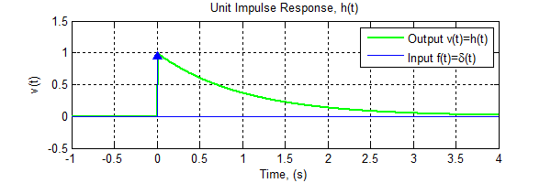
Response of Linear System
‹#›
Impulse response h[t]
output of the system to the input δ[t].

Slide 8
Response of Linear System
‹#›
Impulse response h[t]
output of the system to the input δ[t].
Convolution: Response of a linear system with impulse response, h, to a general signal

Slide 9
Convolution – Input side
‹#›
i=1
i=2
i=3
Input
a1 | a2 | a3 | a4 | a5 | a6 | a7
Kernel
k1 | k2 | k3
k1 | k2 | k3
Output

Slide 10
Convolution – Output side
‹#›
Input
a1 | a2 | a3 | a4 | a5 | a6 | a7
Kernel
k3 | k2 | k1
k3 | k2 | k1
Output
i=1
i=2
i=3

Slide 11
Convolution
‹#›
s[0].h[n]
s[m]
s[1].h[n-1]
h[m]
s[2].h[n-2]

Slide 12
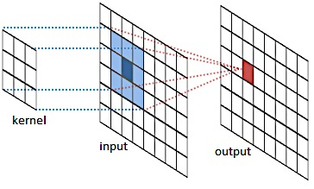
2D Convolution
‹#›

Slide 13
Properties of Convolution
‹#›
All pass system
Amplifier (k>0) / attenuator (k<0)
Delay

Slide 14
Properties of Convolution
‹#›
Commutative
Associative
Distributive

Slide 15
Properties of Convolution
‹#›
Cascading convolutions
Combination of parallel convolutions

Slide 16
Blurring filters
‹#›
More blurring implies widening the base and shortening the height of the spike further.
What does it look like?
Box filters are not best blurring filters but the easiest to implement.

Slide 17
Duality
‹#›
Spatial Domain
Frequency Domain

Slide 18
Duality
‹#›
Spatial Domain
Frequency Domain
Widening in one domain is narrowing in another and vice-versa.

Slide 19
Duality
‹#›
Convolution of two functions in time/spatial domain is a multiplication in frequency domain
Vice Versa

Slide 20
All Pass Filter
‹#›

Slide 21
Low Pass Filter
‹#›
k[t]
K[f]
F
t
f
a(t)
X
A(f)
t

Slide 22
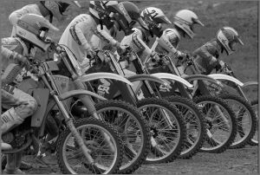
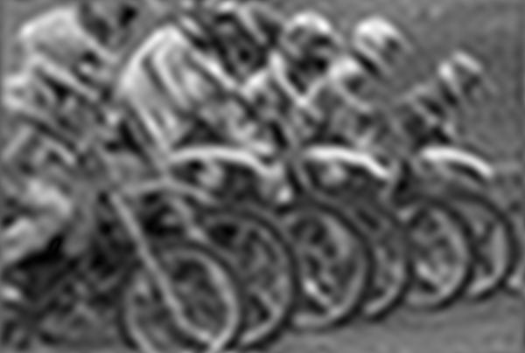
Low Pass Filtering
‹#›
Box filter is known as low pass filter.

Slide 23
Box Filter
‹#›
Effect of increasing the size of the box filter

Slide 24
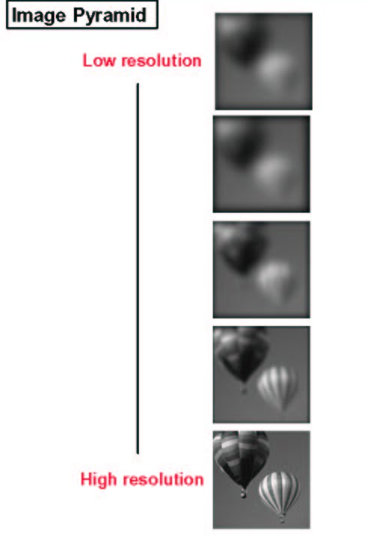
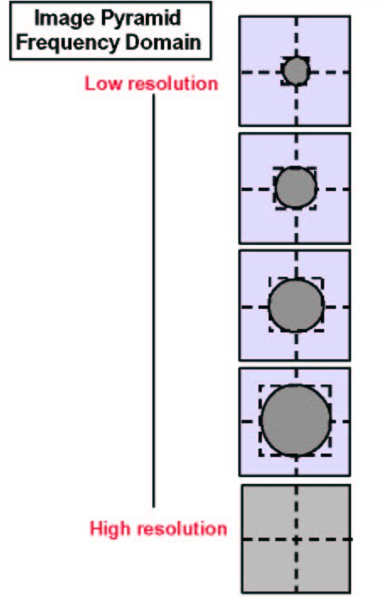
Gaussian Pyramid
‹#›

Slide 25
Gaussian Pyramid
‹#›

Slide 26
Box is not the only shape
‹#›
Gaussian is a better shape
Any thing more smooth is better
x[t]
X[f]
F
t
f

Slide 27
Hierarchical Filtering
‹#›
1/4
1/4
1/4
1/4
N x N
N/2 x N/2
N/4 x N/4
1 x 1

Slide 28
Issue of Sampling
‹#›
As an image undergoes low pass filtering, its frequency content decreases
Minimum number of samples required to adequately sample the low pass filtered image is less.
Low pass filtered image can be at a smaller size than the original image.

Slide 29
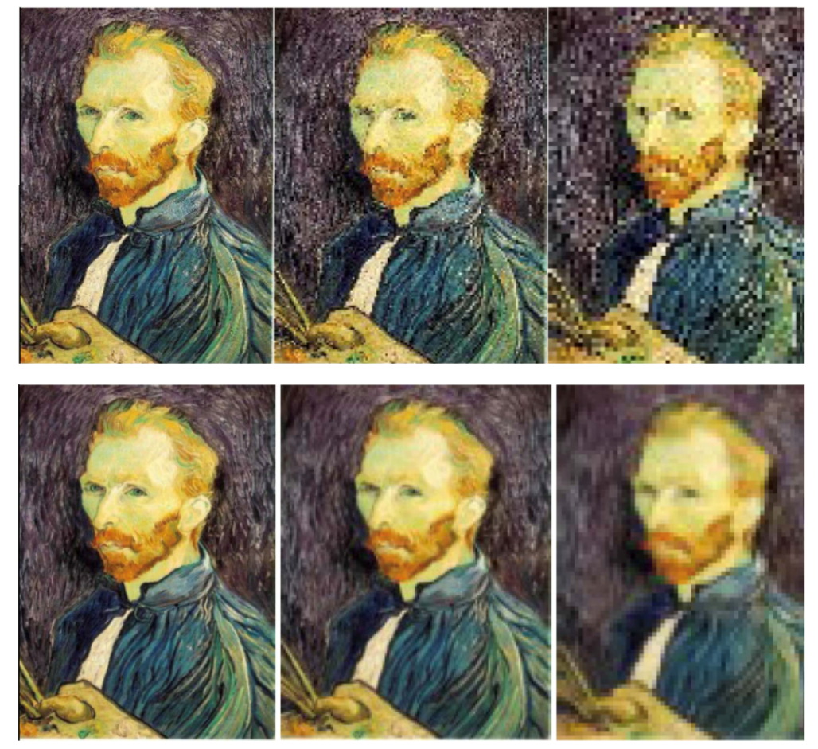
Subsampling
‹#›
Simple subsampling
Pre-filtering and subsampling

Slide 30
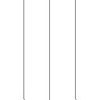
Aliasing Artifact
‹#›
Filtering reduces frequency content.
Hence, lower sampling is sufficient.
Input (256 x 256)
ANTI-ALIASING
Filtered (256 x 256)
Insufficient sampling.
Hence, aliasing.
Subsampled(128 x 128)
Subsampled from filtered image(128 x 128)

Slide 31
High Pass Filter
‹#›

Slide 32
High Pass Filter
‹#›
Original Image
Low pass filtered
High pass filtered

Slide 33
Band-limited Images (Laplacian Pyramid)
‹#›
B_{n-1}= G_{n-1}-G_{n-2}
f_{n-2}<f_{n-1}<f_{n}
B_{n}= G_{n}-G_{n-1}
f_{n-2}
f_{n-1}
f_{n}
G_{n-2}
G_{n-1}
G_{n}

Slide 34
Band-limited Images (Laplacian Pyramid)
‹#›

Slide 35
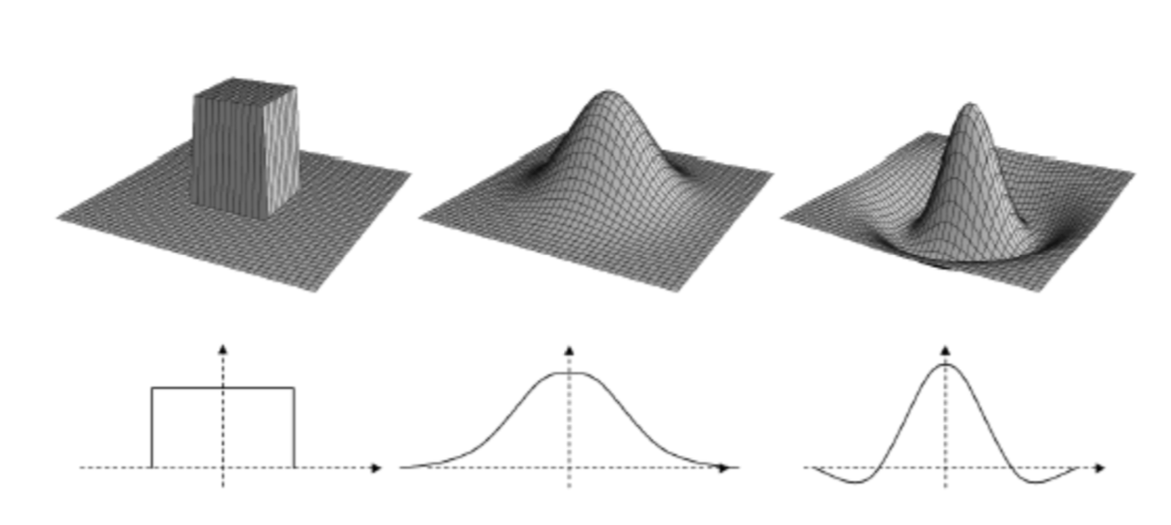
2D Filter Separability
‹#›
Visualizing 2D filters from their 1D counter part
Box Filter
Gaussian Filter
High Pass Filter

Slide 36
2D Filter Separability
‹#›

Slide 37
2D Filter Separability
‹#›
Advantage
Separable filters can be implemented more efficiently
Convolving with h
Number of multiplications = 2pqN
Convolving with a and b
Number of multiplications = 2(p+q)N

